Slide 1
ARRAY IN C++

Slide 2
WHAT IS ARRAY?
An array is a group of consective memory locations with same name and data type.
Simple variable is a single memory location with unique name and a type.But an Array is collection of different adjacent memory locations. All these memory locations have one collective name and type.

Slide 3
DECLARATION OF AN ARRAY:
Like a regular variable, an array must be declared before it is used. A typical declaration for an array in Visual C++ is:
type name [elements];
type is a valid type (like int, float...)
name is a valid identifier
elements field (which is always enclosed in square brackets []), specifies how many of these elements the array has to contain.

Slide 4
EXPLANATION:
INT NUM[6]
size of the array
Base type
name of array

Slide 5
ADVANTAGES OF ARRAY:
Arrays can store a large number of value with single name.
Arrays are used to process many value easily and quickly.
The values stored in an array can be sorted easily.
The search process can be applied on arrays easily.

Slide 6
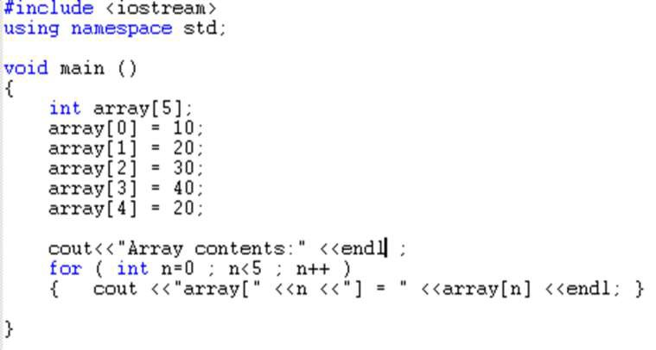

EG. PROGRAM:

Slide 7
TYPES OF ARRAY:
Single dimensional array
Two dimensional array

Slide 8
ONE DIMENSIONAL ARRAY:
A one dimensional array is one in which one subscript /indices specification is needed to specify a particular element of array
Declaration :
Data_type array_name [size of array ];
Eg:
Int num[10];

Slide 9
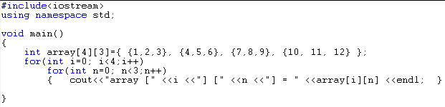
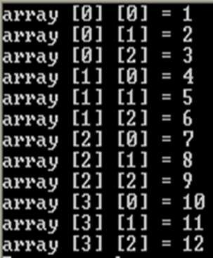
EXAMPLE PROGRAM:

Slide 10
MEMORY REPRESENTATION:
num[0] num[1] num[2] num[3] num[4] num[5] num[6] num[7] num[8] num[9]
39 | 56 | 23 | 98 | 6 | 56 | 9 | 2 | 54 | 67
2000 2002 2004 2006 2008 2010 2012 2014 2016 2018
starting Address of location
Total memory in bytes that an array is occupied :
Size of array=size of array*size of(base type)
Hear,
10*2=20

Slide 11


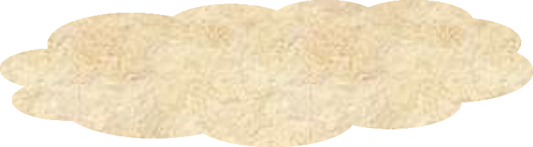
TWO DIMENSIONAL ARRAY:
A 2-d array is an array in which each element is
itself an array
i.e int num[4][3]
0 1 2
0
1
2
3
No of colu mns
No of rows
No of element in 2-D array =M*N
Num [2][1]

Slide 12
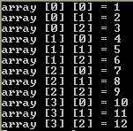
EXAMPLE PROGRAM:

Slide 13
MEMORY REPRESENTATION:
Total bytes= no of rows*no of columns*size of(base type)
Memory reprsentation in 2-D array: char A [2][3]
A[0][0] A[0][1] A[0][2] A[1][0]
A[1][1]
A[1][2]
5001
5002
5003
5004 5005 5006

Slide 14
Class Problems:
Write a c++ program to accept 10 sequence id and store it in array variable and display all sequence id.(user input and loops)
Write a c++ program to accept 2x2 matrix from user and display the same in matrix format
Write a c++ program to accept 5 subject marks and store it a array and display all marks and also find total marks.
Write a c++ program to accept 3x4 matrix from user and display the same in matrix format
Homework Problems:
Write a c++ program to accept 3x3 two separate matrix from user and perform addition of that matrix and display the sum matrix

Slide 15
THANK YOU

